Slide 1

AdView

Slide 2

AdView
Software for transferring graphical and semantic 2D/3D data from various CAD/BIM/PLM platforms
Allows you to combine information about an object from various sources in a single model and transfer graphic and attribute information in a single p3db format between all participants in the life cycle of an industrial or other object

Slide 3
Fast
Its own graphics core combines polygonal and parametric graphics, which allows you to effectively work with large BIM models of large-scale technological objects
Easy & Intuitive
The interface allows access to information even if you have no experience working with CAD products
Universal
Allows you to work with most popular CAD/BIM/PLM platform formats
Light
Fast and stable operation is ensured even on ordinary office PCs and laptops in a minimal configuration
Element | Requirement
Operating system | Windows 10/8/7/Vista/XP/2000/NT
CPU | Family Intel Pentium / Celeron (or compatible) 450 MHz or higher processor
 | Family AMD K6 / Athlon / Duron (or compatible) 450 MHz or higher processor
GPU | With support for OpenGL 1.1 and higher
Memory (RAM) | 128 MB (minimum)
Hard Drive | 8 MB of space to install

Slide 4
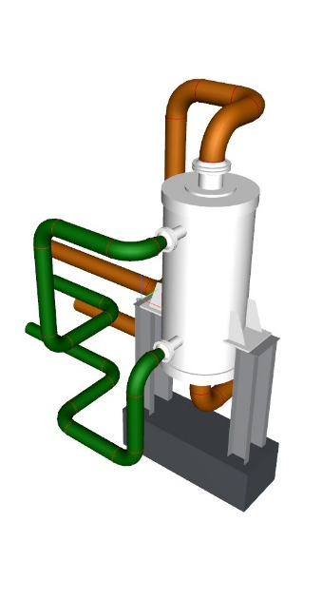
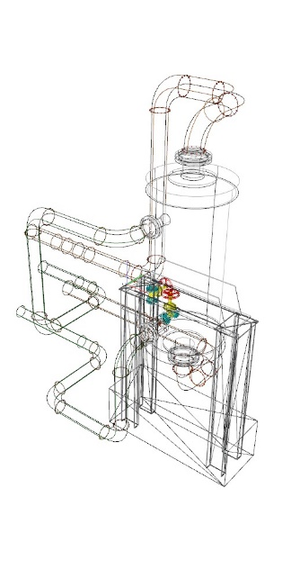
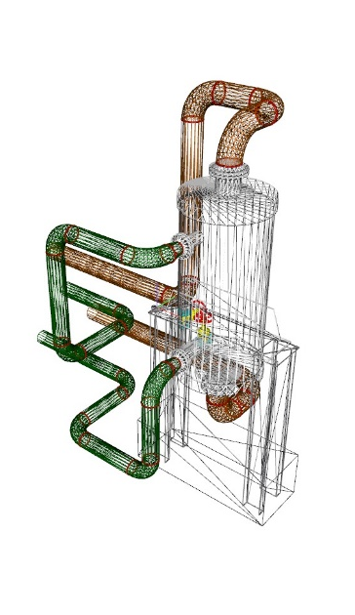
Direct import, without using intermediate formats, allows you to reduce the weight of the original model up to 100 times (for RVT models) without losing graphic and attribute information. In this case, the processing time of the model takes several seconds.
P3DB
IFC
Up to 100 times lighter/ faster

Slide 5
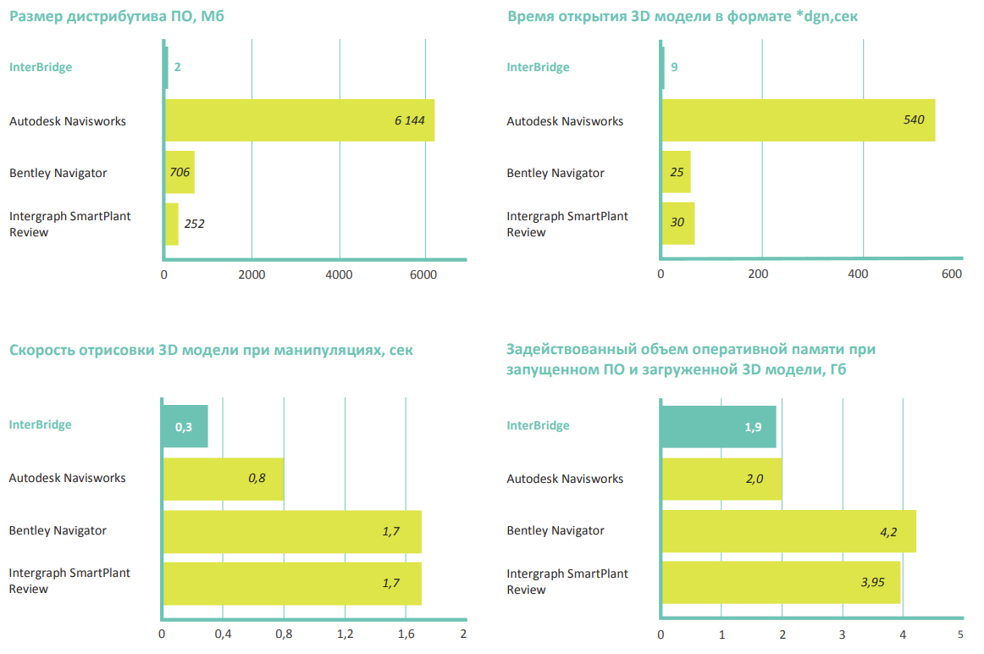
AdView
AdView
Speed of drawing a 3D model during manipulation, sec
Used amount of RAM when the software is running and the 3D model is loaded, GB
Opening time of a 3D model in *dgn format, sec
AdView
Notes:
5

Slide 6
Technologies
AdView's core uses unique proprietary technologies, making it a fast and convenient tool for visualizing and navigating 3D models and 2D drawings, even for large and distributed models during design, construction, and operation
1
Converting BIM models to AdView format
2
Merging CAD Models
3
Integration with related IS

Slide 7












Combining CAD models and integration with related IS
AdView supports data conversion from most popular CAD/BIM/PLM platforms into its proprietary lightweight P3DB format
P3DB model format
Fast loading compact storage format. Allows further optimization of BIM model data
P3DW project format
Combines several BIM models in P3DB format. Allows you to automatically obtain the most current version of the generalized model

Slide 8
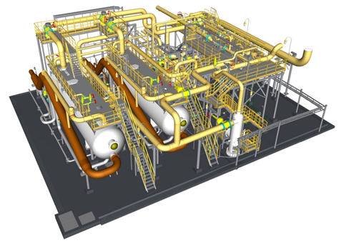
Tools
AdView offers a wide range of tools for working with geometry and attribute information of a BIM model
1
Navigation
2
Model editing
3
3
Geometric measurements and annotations
4
PBS editing
3
5
Attribute editing
6
Work with point clouds

Slide 9
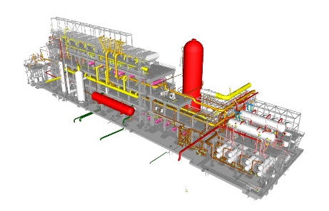
Open API and Extensions
The core of AdView provides the ability to develop additional external tools with access to all data and functions in the form of a stand-alone application or plug-in
Utilities that extend the standard functionality of AdView
1
Restructuring tool
1
2
RegExTool
2
3
CSVAttributes
3
4
Collision Manager ExCollider

